Slide 1
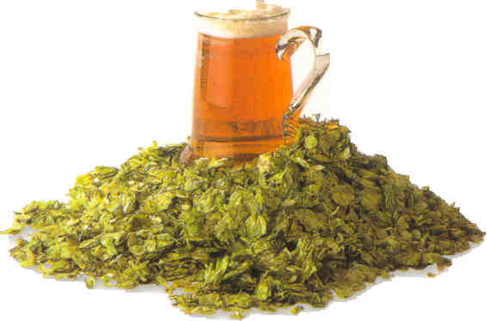
THE WORLD OF
“BEER”

Slide 2
HISTORY OF BEER
Beer originates from the Anglo-Saxon word “Baere” meaning barley.
The first detailed mention of beer was made more than 5000 years ago by the Sumerians, who lived in the fertile land between Tigris & Euphrates ( now called Iraq).
Mesopotamian’s had the know-how in 2100 B.C

Slide 3
HISTORY OF BEER
Alexander the Great took beer to Greece and the production was placed under the royal rule.
In the continent, monasteries were the citadels of brewing with major centers being Cologne & Hamburg. The monks across Europe helped to nurture the art of brewing during this period and their malt was specially valued.
In England in 1188 first national beer tax was levied in order to finance the crusades.

Slide 4
HISTORY OF BEER
The monks of Bavaria were responsible for an innovation that was to change the face of brewing - bottom fermentation. This bottom fermented beer could be stored for much longer periods - a process known as lagering, from the German word for storage.
In 1516, The Bavarian code of purity was established. This was called “rheinheitsgebot”
After the religious wars Bavaria emerged as major brewing centre ( 1618 - 1648 )

Slide 5
HISTORY OF BEER
In 1800’s in Plzen,( later part of the Czech republic) 250 families formed a co-operative called the “Citizen Brewery”, and the new product was called “Pilsner Urquell”.
The brew of 1838 was disastrous.
They then employed a Bavarian brewer , Josef Groll to brew their beer using the bottom fermentation method.

Slide 6
HISTORY OF BEER
On 5 October 1842, Josef Groll mashed his first batch of beer in Plzen ( known by its German name of Pilsen), and the world’s first ever golden coloured lager was born!
Soon what came to be known as the Pilsner style was copied all across the world.
The 19th century was the “Century of Refrigeration” bringing about the chilling breakthrough.

Slide 7
The Ingredients
INGREDIENTS
Barley The grain undergoes a complex series of changes - germination, roasting, and mashing before reaching a drinker’s glass.
Water The greatest ingredient of all, ideally should be salty and with less mineral content

Slide 8
The Ingredients
AGENTS
Hops One of the most aromatic species in the plant kingdom.Used for fermentation and preservation.
Yeast The crucial ingredient for fermentation.

Slide 9
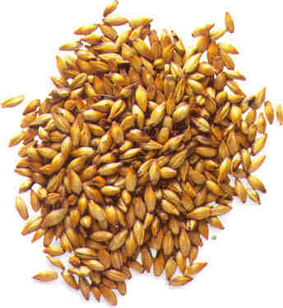
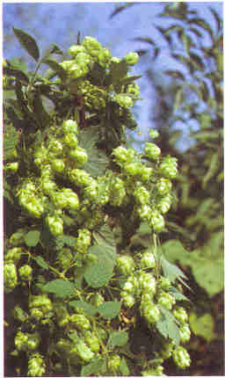
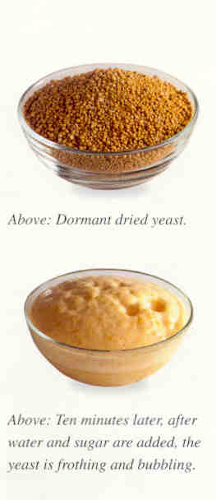
Barley
Hops
Yeast

Slide 10
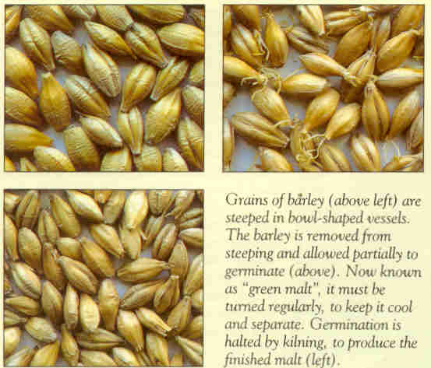

Slide 11
MANUFACTURE OF BEER
The Basic Recipe
Barley is turned into Malt.
Malt is cooked in hot water.
Hops are added as an agent for flavoring and preservation.
Yeast is added to bring about the fermentation.

Slide 12
MALT
Barley provides the best extraction rate of sugars, and therefore by far the most favoured by brewers the world over.
To produce good malt, the barley must have plump sound grains and must germinate at an even rate. Should be low in nitrogen, as nitrogen affects fermentation.
Barley is dried in order to reduce the moisture it has retained. It is kept dormant for a month. Since it later improves germination, and ensures a longer shelf life ( a year ).

Slide 13
MALT
Soaking the Grain
In traditional floor malting, the grain is soaked in large water cisterns for 2-3 days.
Germination
The damp grain is emptied onto huge germinating floors, and evenly spread, where it is allowed to stay for a period of 5 days to sprout & grow. This is an important process, as it changes starches in the seeds to sugar. At this stage the malt is called “Green Malt”

Slide 14
MALT
Baking
Germination is brought to a sharp halt, where the “Green Malt” is send to the kiln, where it is baked for 2 days at 80-110 C. Some use wood fired kilns to give the malt a smoky flavour. The higher the temperature, the darker the colour and stronger the flavour.
Brewers skillfully blend different malts to produce different beers.

Slide 15
MALTING
BASIC PURPOSE:
  To render soluble starches contained the barley.
THE ACTION:
Polysaccharides
THE STEPS:
  Controlled germination by steeping.
  Drying is done, roasting to produce dark beer.
  malt is milled into grist.
Maltose
Dextrin
Alcohol
Fullness
of flavours

Slide 16
STEPS
The first stage of Brewing Process :
Malt mixed with hot water to form mash.
The vessel is called a mash tun.
Objective is conversion of starches in malt into fermentable sugars.

Slide 17
STEPS
Mashing takes place by 2 methods :
Infusion = carried out at a temp of 65-68deg C for 1-2 hrs. Results in warm, thick, sweet liquid called “sweet wort”, which is drained out.
Decoction = More widely used, brings about more exhaustive conversion of starches. Batches of mash are slowly brought to a boil, and returned back to the mash. Starts at 35deg C until temps reach 75deg C.

Slide 18
STEPS
Process could last for 5-6 hours.
The aim of this method is to extract as much sugar from the malt at different temperatures.
The method is usually used in conjunction with another filter vessel called the lauter tun.

Slide 19
STEPS
The lauter tun contains rotating blades / knives that keep the bottom of the mash open, thus allowing the sweet wort to drain more easily.
This is the liquid from which beer is brewed.

Slide 20
BREWING
THE PURPOSE:
  To obtain the basic fermentable liquid for the production of beer.
THE ACTION
  GRIST
  Add H2O
  ( warm)
  MASH
  BOIL
  WORT
THE STEPS:
  Grist is fed into mash tun.
  water is added to form a porridge like mash.
  done by:
    infusion
    decoction
  mash is filtered in the lauter tun. and the clarified liquid is known as wort.
  The hops are added and the the liquid is boiled.

Slide 21
HOPS
Scientific Name: Humulus Lupulus
Only the female flowers from the plant are used.
The female cone is made up of a number of petal like structures called bracts.
The brachioles of this plant secrete a resinous substance ( called lupulin ) which is responsible for the taste and the flavour of the beer. It also brings about bitterness in the beer.

Slide 22
HOPS
Best HOPS come from Belgium and Czechoslovakia.
In India HOPS comes from Kashmir and Himachal Pradesh.

Slide 23
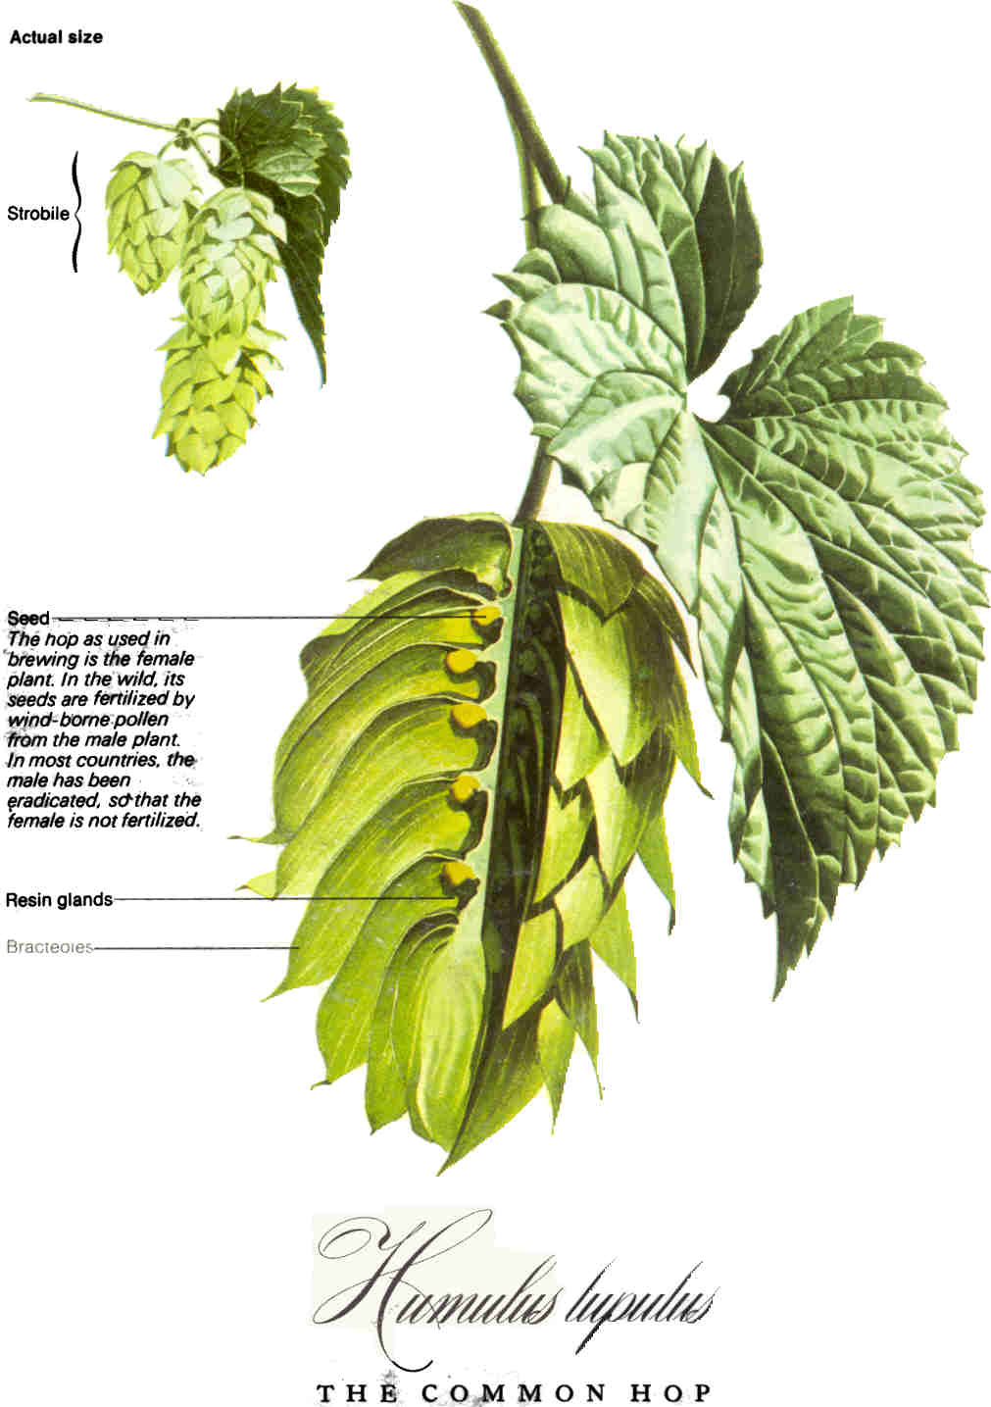

Slide 24
BREWING
HOPS
The wort is fed into a brew kettle ( often referred to as COPPERS),where it is heated to a boiling point (between 1/2 hr – 2 &1/2 hrs).
Heat normally applied through steam.
The process brings about great changes in the nature of the wort.
Hops added at this stage in pellet or whole form, which releases their oils to provide the final aroma.

Slide 25
BREWING
HOPS
On completion, hops are removed through a hop extractor ( like a lemon squeezer ).
The “hopped wort” is then passed through a whirlpool / centrifuge to remove unwanted protein.
It is then passed through a cooler / heat exchanger, where it is brought down to a temperature suitable for fermentation. This varies according to the type of beer being produced.

Slide 26
FERMENTATION
THE STEPS:
  Temp. is brought down, suitable for fermentation.
  Takes place in fermentation vessels.
  Yeast is added.
  Temp. cycle 7-12-7 deg C is used (bottom fermented)
  Temp cycle 15 - 20 deg C is used (top fermented)
  Lasts for a week.
  It is called the primary fermentation.
THE PURPOSE
To convert the simple sugars in the hopped wort to alcohol.
THE ACTION:
C6H12 O6
2C2H5OH + 2CO2

Slide 27
FERMENTATION
After the yeast has fed on the sugar rich wort for a week, the liquid, now known as “green beer” is run into conditioning tanks, where it is left to settle & mature.
Conditioning builds up the beer’s carbon dioxide, which gives the beer its head when poured.
At this stage, Krausening or Priming is carried out to stimulate a secondary fermentation.

Slide 28
CONDITIONING THE BEER
THE PURPOSE
  Further fermentation of the more stubborn sugars takes place.
  Some times the process is stimulated by addition of partially fermented wort. This process is called KRAUSENING
Process of conditioning is also known as:
Maturing / Ripening /Aging/ Lagering

Slide 29
CONDITIONING THE BEER
Most beers are filtered between conditioning & packaging, wherein they are passed through filters.
Finings (a glutinous substance from fish bladders- isinglass) are added to the cask / vessel / tanks to clarify the beer.

Slide 30
CONDITIONING THE BEER
Pasteurization
Beer is heated to kill any bacteria that may have entered during the brewing process.
Increases shelf life & stability of the product.
Eradicates unwanted organisms and kills the yeast in the beer.
Tunnel = 50 deg C , 45 mins
Flash = 72 deg C, 30 secs

Slide 31
PRODUCTION OF BEER
Steeping of barley
Drying of barley
Milling into grist
Mash is formed Mash Tun

Slide 32
Wort is obtained Lauter Tun
Brewing Brew Kettle
Cooling
Fermentation Fermentation vessel
Conditioning Holding Tanks

Slide 33
Pasteurisation
Bottling

Slide 34
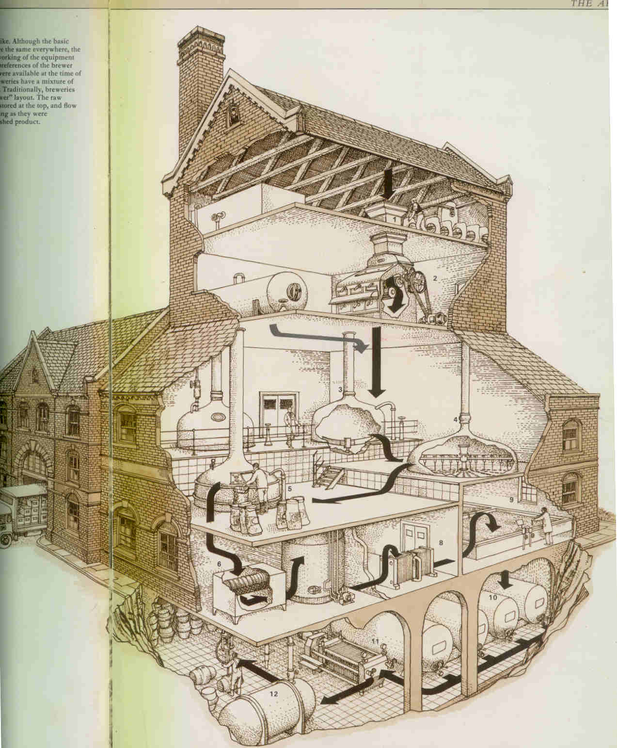

Slide 35

THE CLASSICAL BEER STYLES
TOP FERMENTED
WHEAT BEER
BOTTOM FERMENTED

Slide 36
TOP/BOTTOM FERMENTED BEER
Bottom fermented
Yeast
  Saccharomyces carlsbergensis
Primary fermentation
  Takes place at 7-12-7 deg C
Holding
  Last for about a month.
Top fermented
Yeast
  Saccharomyces cerevisiae
Primary fermentation
  Takes place at 15-20 deg C
Holding
  Last for about a week

Slide 37
TOP/BOTTOM FERMENTED BEER
Bottom fermented
Krausening
Service
  4-6 deg Centigrade
Top fermented
Priming
Service
  18-20 deg Centigrade

Slide 38
TOP FERMENTED BEER
Ales
  Generic term for English styles top fermented beer. Copper coloured or darker. Served at room temp.
Porter
  Originally local London beer made with roasted un-malted barley. Strength 5-7.5% v/v.
Trappiste
  Ale type beer produced exclusively in Belgium and The Netherlands. Strength 6-8 % v/v
Kolsch
  Product of Cologne - Bonn area, usually served with German sausage.

Slide 39
WHEAT BEER
Weizenbier
  Originating from Bavaria
  served with a slice of lemon.
  Alcohol content is 5% v/v.
  Weisse (Berliner)
  Originating from Berlin.
  Served with the essence of raspberry juice.
  Alcohol content is 2.5-3% v/v

Slide 40
BOTTOM FERMENTED BEER
Muchener
  Internationally accepted name for dark brown beer.
  In home city it is called Dunkel.
  Alcohol content is 4-4.75% v/v.
Vienna
  Amber coloured beer
  In home city it is referred to as Spezial
  Alcohol content is 5.5% v/v.
Pilsner/Pilsener
  Outside Czechoslovakia usually spelled as Pilsener.
  Golden colour clear bear.
  Alcoholic content 5% v/v

Slide 41
BOTTOM FERMENTED BEER
Bock
  A strong bottom fermented beer
  Often labeled with a goat symbol.
  Alcohol strength not less than 6% v/v.
Dopple Bock
  Extra strong bottom fermented beer.
  First brewed by the Italian workers in Bavaria.
  Brand names end in the suffix --ator.
  Alcoholic content is 7.5-13% v/v

Slide 42
TOP BREWING NATIONS
US
BRITAIN
GERMANY
JAPAN
BRAZIL
UK
MEXICO
RUSSIA
SPAIN
SOUTH AFRICA

Slide 43
BEERS SERVED AT OBEROI HOTELS
Heineken
Budweiser
Tsing Tao
Carona
Tiger
Amstel

Slide 44
BEERS SERVED AT OBEROI HOTELS
Foster
Strohs
Kingfisher
Kalyani Black label

